Slide 1

Sentiment Analysis Web Application using Streamlit
This presentation introduces our Sentiment Analysis Web Application, a powerful tool designed to discover the mood behind the words, instantly analyze the emotion behind articles, tweets, and posts.
Name: Jahnavi Naidu (23BCE8395)
Name: Deva Mohitha (23BCE9166)

Slide 2

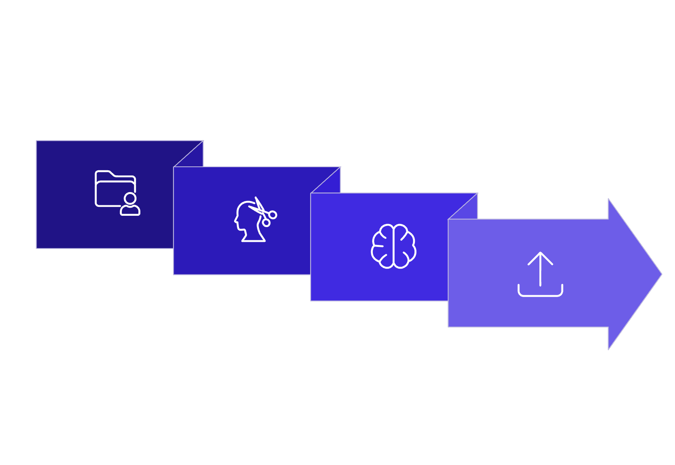




Project Overview
Python-based Sentiment Analysis Web App
Unlike backend scripts → a fully functional web tool
Data Ingestion
Web Scraping
Visualisation
Built with:
Streamlit → Interactive UI
Pytesseract (OCR) → Reads text from images
Newspaper3k → Web scraping
Core innovation: Handles both plain text + image text
OCR Extraction
NLP Analysis
Combines NLP + OCR + Data Visualisation in one dashboard
Offers a simple, user-friendly, and powerful analysis tool
SOLUTION:
Keyword Filtering: Analyze by keywords or topics.
Preprocess
Text & Image: OCR extracts text from images.
gana
Multi-Metric: Polarity, subjectivity, word count, pronouns.
Real-Time Results: Instant analysis display.
Visualisation: Bar charts for trends.
User-Friendly: Easy for anyone to use.
Insights: Understand sentiment and patterns quickly.
Data Ingest
Analyse

Slide 3
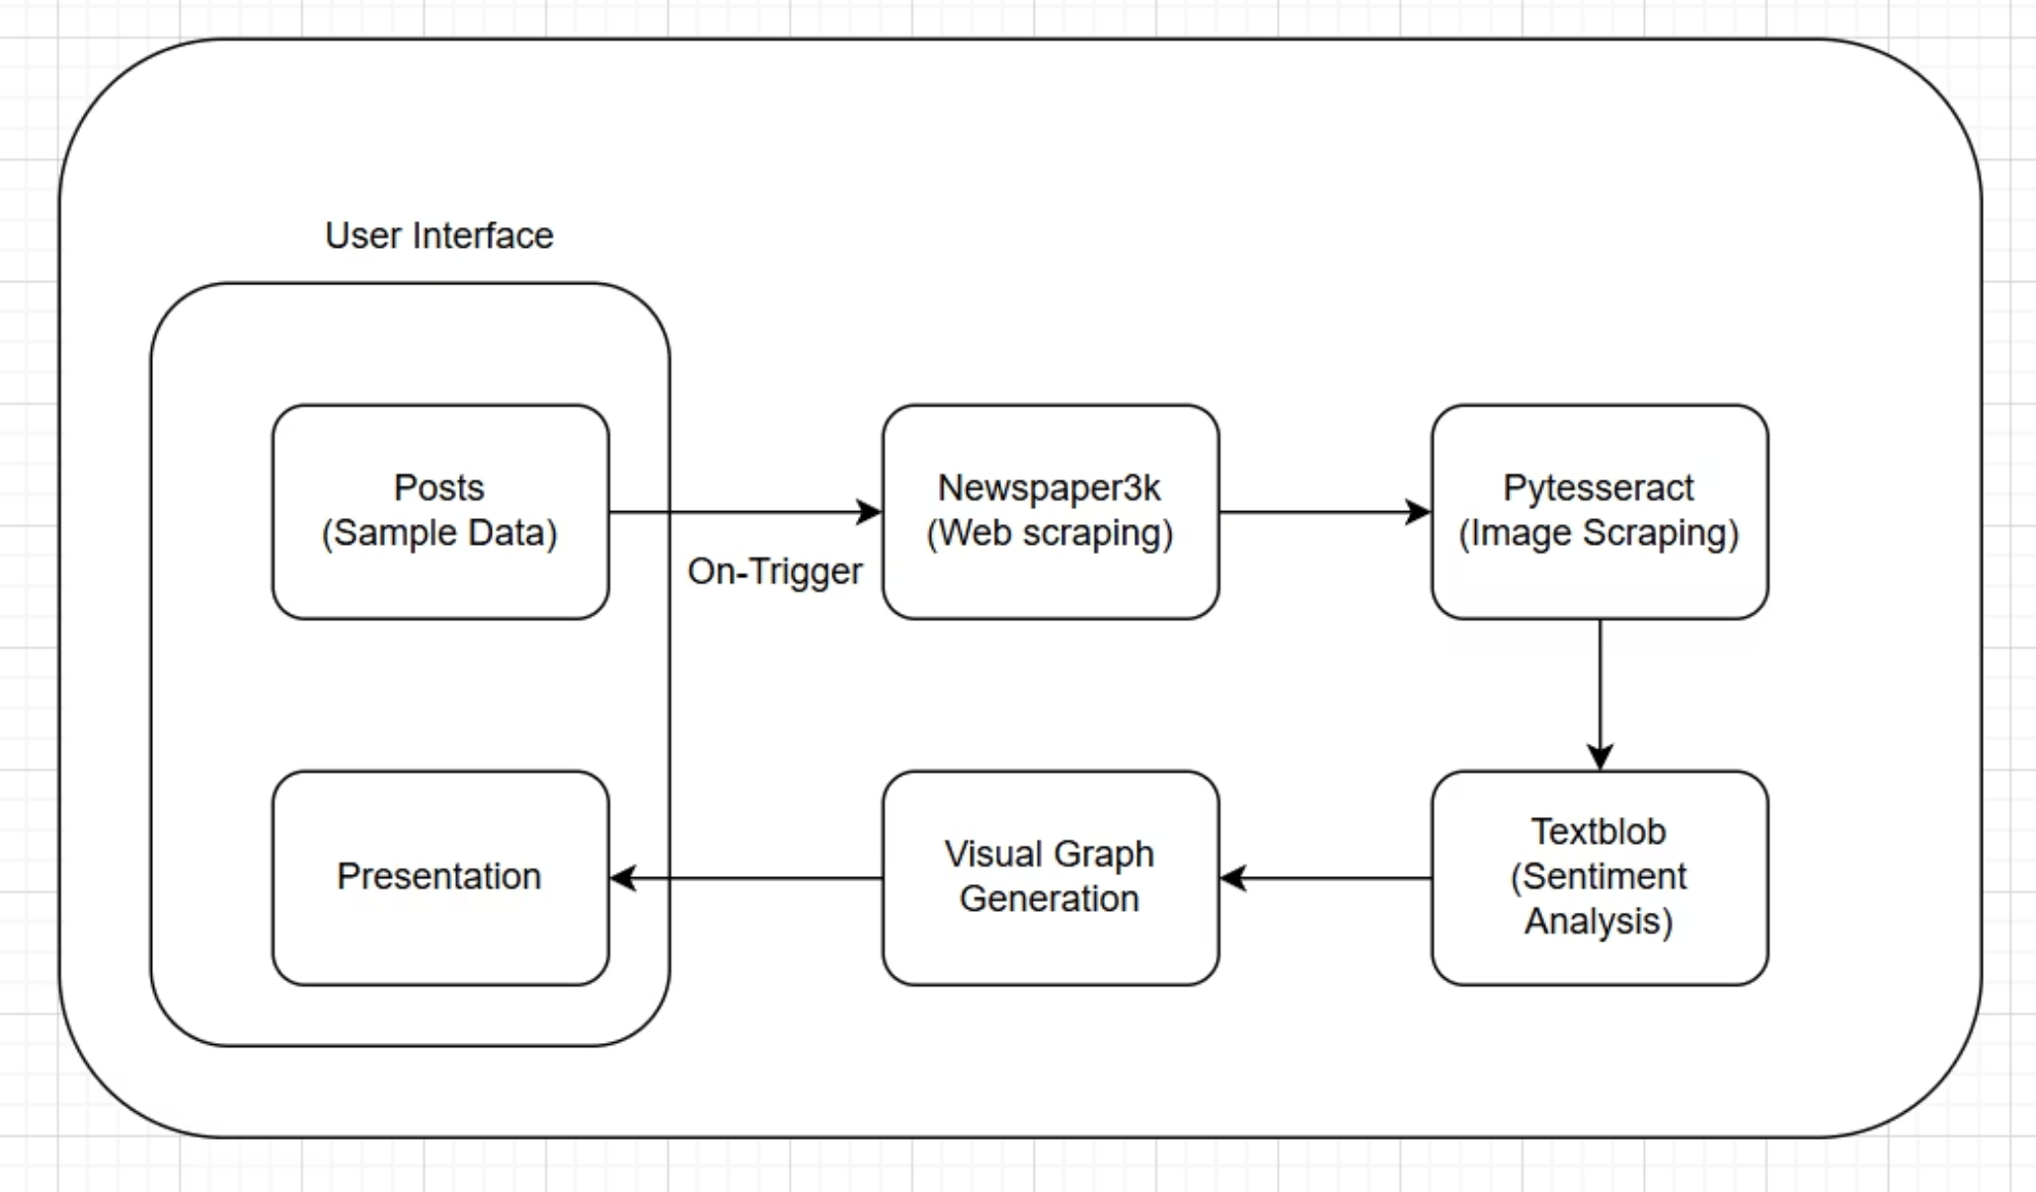
Our Robust Architecture
Our application's architecture is designed for seamless data flow, from diverse inputs to insightful visualisations. It integrates powerful libraries to ensure efficient processing and a user-friendly experience.
This streamlined process enables comprehensive sentiment analysis across various content types,
delivering actionable insights directly through the interactive Streamlit interface.

Slide 4
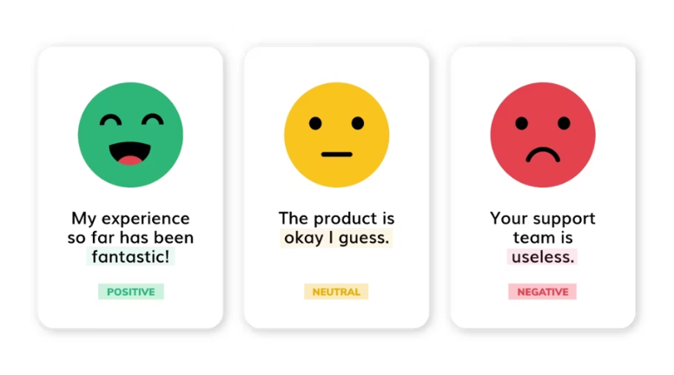
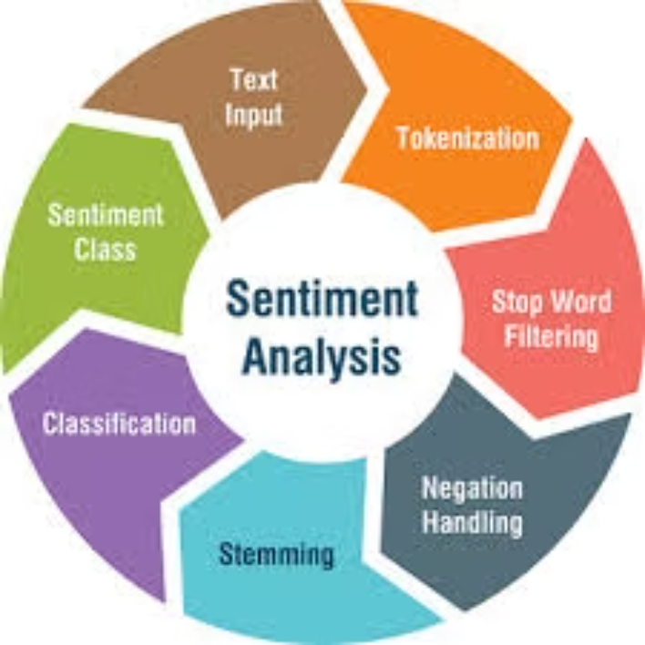
Unpacking Sentiment Analysis
A core NLP technique
Classifies text as Positive, Negative, or Neutral
Helps identify the overall mood or sentiment of content.
Supports decision-making by revealing public opinion trends.
Applications:
Customer feedback & reviews
Public opinion & surveys
News & media reporting
Helps uncover trends, attitudes, and emotions in digital content
Empowers organizations to make data-driven decisions
Detects bias & tone in text
Supports market research & brand tracking
Why is it useful?
Helps find trends, emotions, and attitudes hidden in digital content.
Lets companies make better decisions based on real data.
Supports market research and brand monitoring by showing what people think.

Slide 5



Broad Applications Across Sectors
Our Sentiment Analysis Web Application provides valuable insights for a wide range of users and industries, transforming how digital content is understood and utilised.
For Students
Aids in studying how news and media outlets frame and present critical issues
for academic research.
For Businesses
Helps track public sentiment and customer feedback about products, services,
and brand perception.
For Researchers
Facilitates easier identification and analysis of public opinion trends across
various topics and datasets.
For Casual Users
Offers an engaging and intuitive way to explore and analyse the emotional
tone of favourite topics.

Slide 6



Our Driving Motivation: Bridging the Gap
Information Overload
Tooling Limitations
The Need for a Holistic Solution
Opinions shape public behaviour
Some are too hard for non-technical users.
There’s a need for a simple and accessible sentiment analysis tool.
Huge volume of online content daily
Manual analysis is impossible
Current tools miss a lot of valuable information.
Multi-dimensional analysis ensures broader coverage.
Need for automation
Helps make sense of vast information quickly.
Images are common in online communication.
Helps make sentiment analysis more accurate and inclusive.
Tools need to handle both text and images.
Provides deeper, more meaningful insights.

Slide 7






Our Robust Technology Stack
Our application is powered by a sophisticated yet accessible suite of modern, open-source technologies, each selected for its specific strengths in delivering a seamless and powerful sentiment analysis experience.
Streamlit
Pytesseract
For the interactive front-end, enabling users to input keywords, analyse articles, and view results in real-time with a clean interface.
An Optical Character Recognition (OCR) engine used to extract meaningful text content from images, expanding the scope of analysis.
Newspaper3k
TextBlob (NLP MODEL)
Manages the efficient scraping and cleaning of raw text from online news articles, preparing them for sentiment processing.
The core sentiment analysis library, providing measures such as polarity (positive ↔ negative) and subjectivity (fact ↔ opinion).
Matplotlib & Seaborn
Excel Dataset(CSV FILE)
Achieve sophisticated data visualisation, presenting analytical results clearly through interactive and insightful bar charts.
Stores a collection of sample articles for quick offline access and provides a convenient source for pre-defined content.

Slide 8


Key Features That Stand Out
Our app is designed with key features that make sentiment analysis easier, more accurate, and user-friendly.
Keyword & Live Scraping
Image Text Extraction
Enter keywords like “climate” or “mental health” to filter relevant articles.
Extract text from images using Pytesseract.
Ensures image-based content is included in analysis.
Use live web scraping via newspaper3k for real-time content analysis.
Expands the scope of data for more complete insights.
Multi-Metric Analysis
Interactive Visualisation
Measures sentiment polarity, subjectivity, word count, syllable complexity, and pronoun usage.
Results shown through interactive bar charts.
Makes complex data easy to understand at a glance.
Provides detailed insights into both emotional and structural aspects of text.
Helps users quickly identify key trends and patterns.

Slide 9




Understanding the Workflow
The project's workflow is meticulously designed to ensure a clear, efficient, and transparent process from
data input to insightful visualisation.
User Input & Selection
Content Retrieval & OCR
Users enter a keyword or choose a topic like "climate" or "global issues" to start analysis.
Articles are retrieved from a local dataset or via online
scraping,
OCR extracts text from images for processing.
Text Preprocessing & Analysis
Results Presentation
Text is preprocessed, then analyzed for polarity, subjectivity, word count, and pronoun usage.
Analytical results are shown as visual bar charts in Streamlit, allowing easy interpretation of sentiment trends.

Slide 10
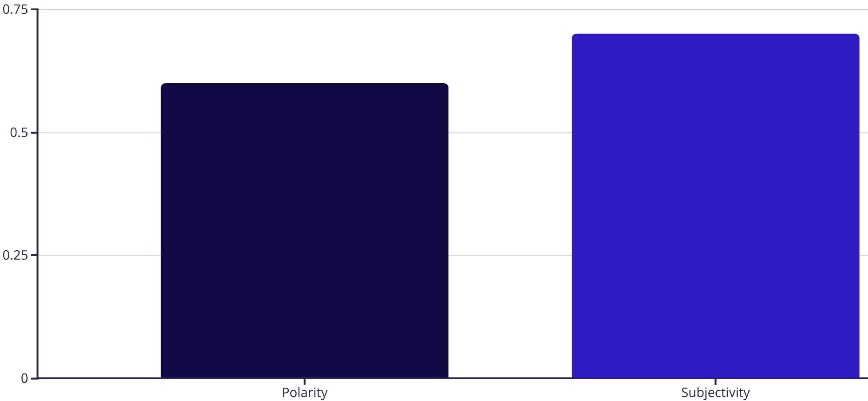
An Illustrative Example Output
To fully grasp the tool's practical utility, let us consider a sample article
text: "The tool analyzes text like“The climate movement is growing stronger worldwide” to provide insights."
+0.6
0.7
Polarity Score
Subjectivity Score
Shows strong positive sentiment, reflecting an affirmative statement.
Indicates the text is opinion-based rather than purely factual.
1.2
8
Avg. Syllables
Word Count
Measures words’ complexity to reflect
linguistic difficulty.
Shows the length of the text.
0
Personal Pronouns
Indicates an objective tone, focusing less on individual perspectives.
The visualisation Clearly presents polarity and subjectivity as distinct bars, making the positive sentiment and
subjective angle immediately apparent, while showing the degree and nature of the opinion.

Slide 11






Broad Applications Across Sectors
This versatile application offers a wide spectrum of practical uses across various industries and domains,
proving its value as a powerful analytical tool.
Content Analysis
Social Media Monitoring
To study the overall tone and sentiment of blogs, news articles, or academic research papers, offering insights into communicative intent.
To track public mood and sentiment around trending topics, brands, or events, crucial for reputation management and market analysis.
Business Intelligence
Political Analysis
For organisations to effectively analyse customer reviews or feedback, gaining actionable insights into product performance and service satisfaction.
To evaluate public sentiment and perception toward policies, political figures, or electoral campaigns, aiding strategic communication.
Educational Tool
Journalism & Media
For academics and researchers, serving as an effective educational resource to teach complex NLP concepts through hands-on, practical exploration.
To help journalists detect potential biases in reporting or identify prevailing narratives, enhancing objective news delivery.

